Slide 1

冒險故事
(animaze)
Notes:
https://unsplash.com/photos/white-explore-flag-z55CR_d0ayg

Slide 2
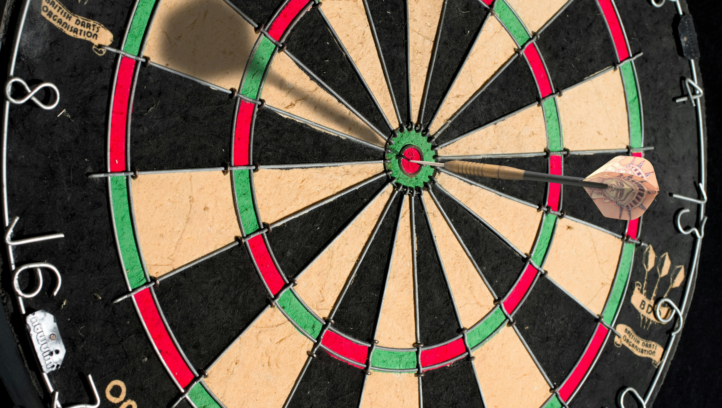
1.目標
Notes:
https://unsplash.com/photos/brown-and-black-round-board-DX3_dXuHVl8

Slide 3
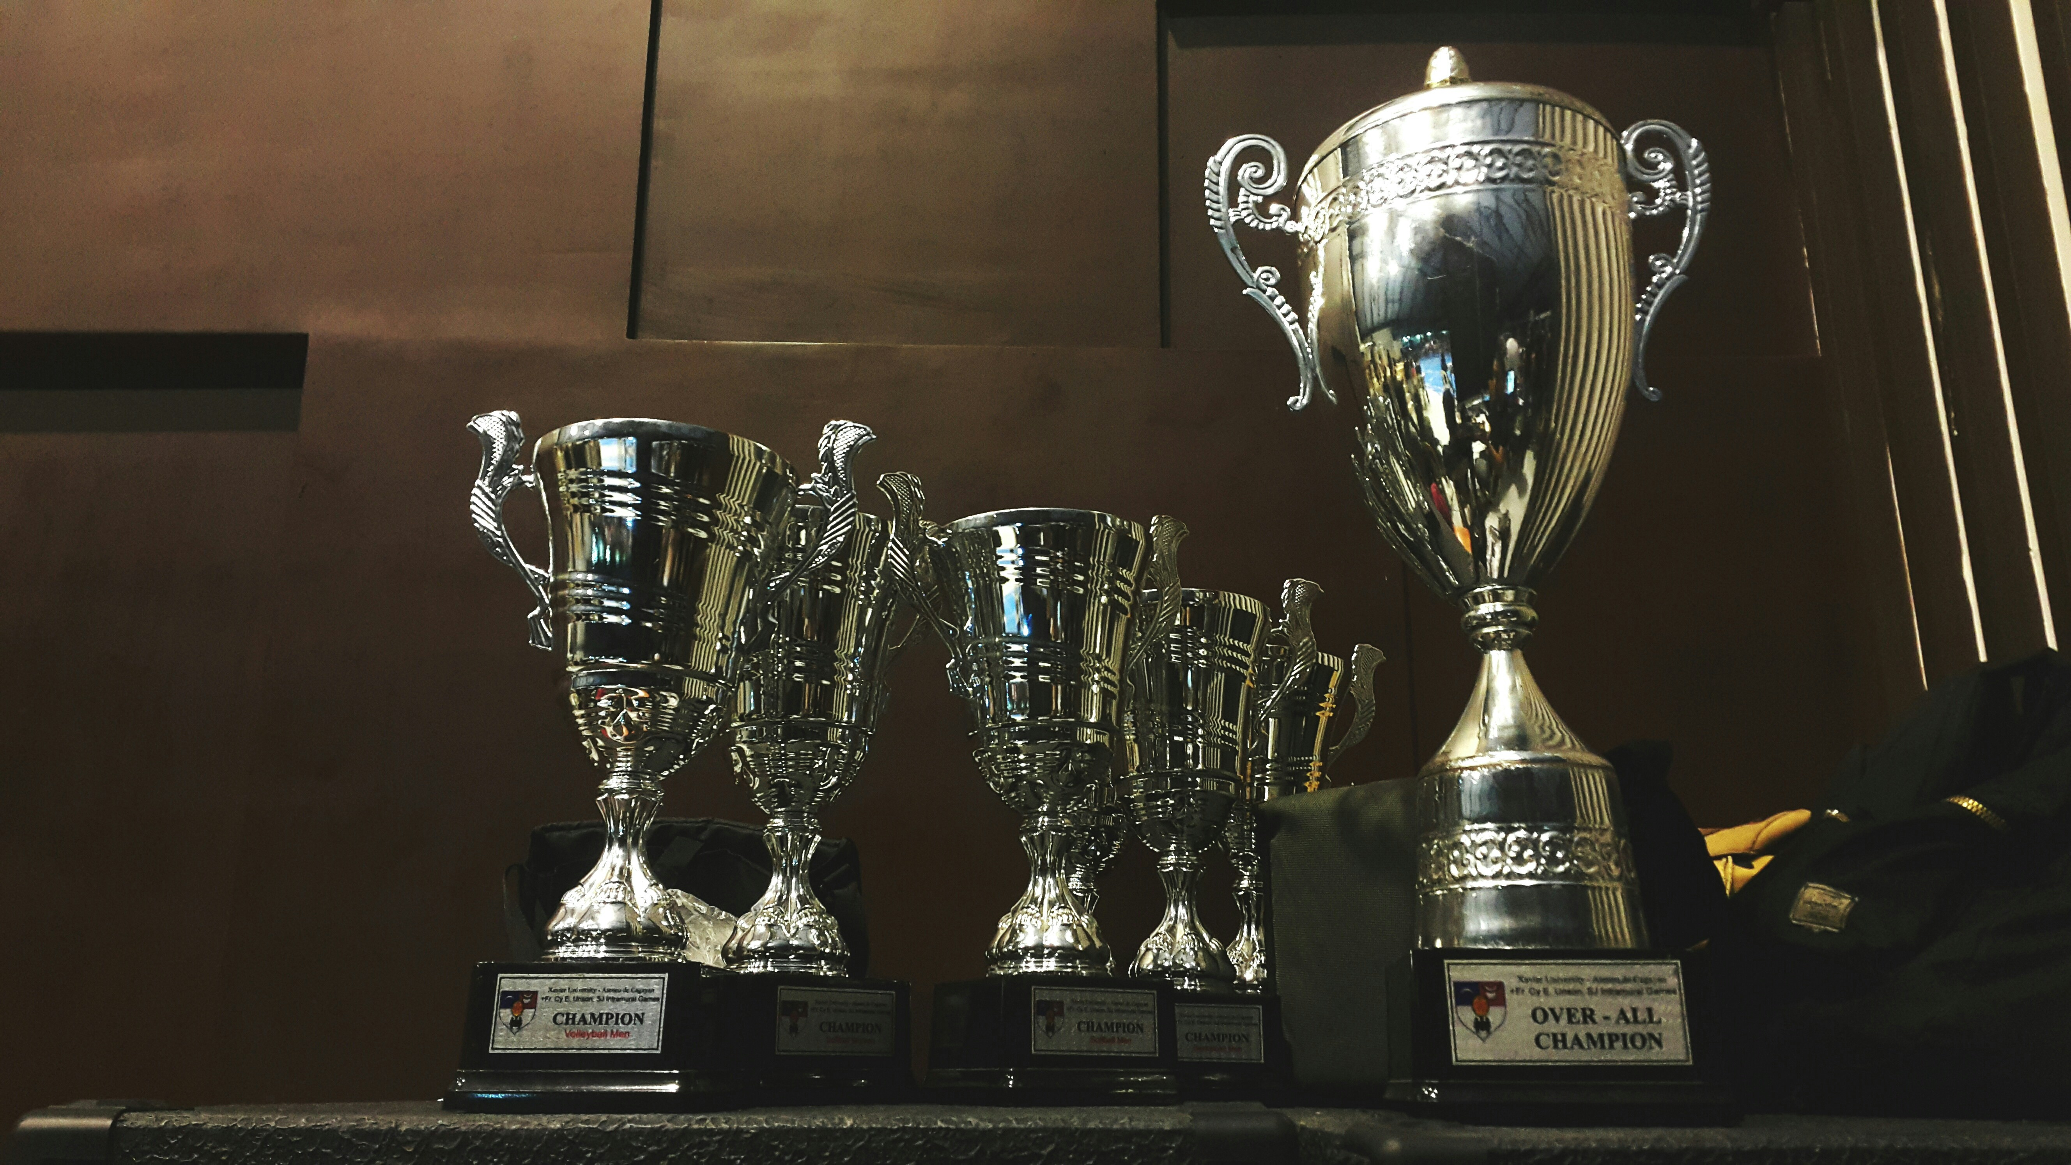
1.目標
Notes:
https://unsplash.com/photos/several-silver-and-gold-trophies-on-wooden-surface-HkN64BISuQA

Slide 4
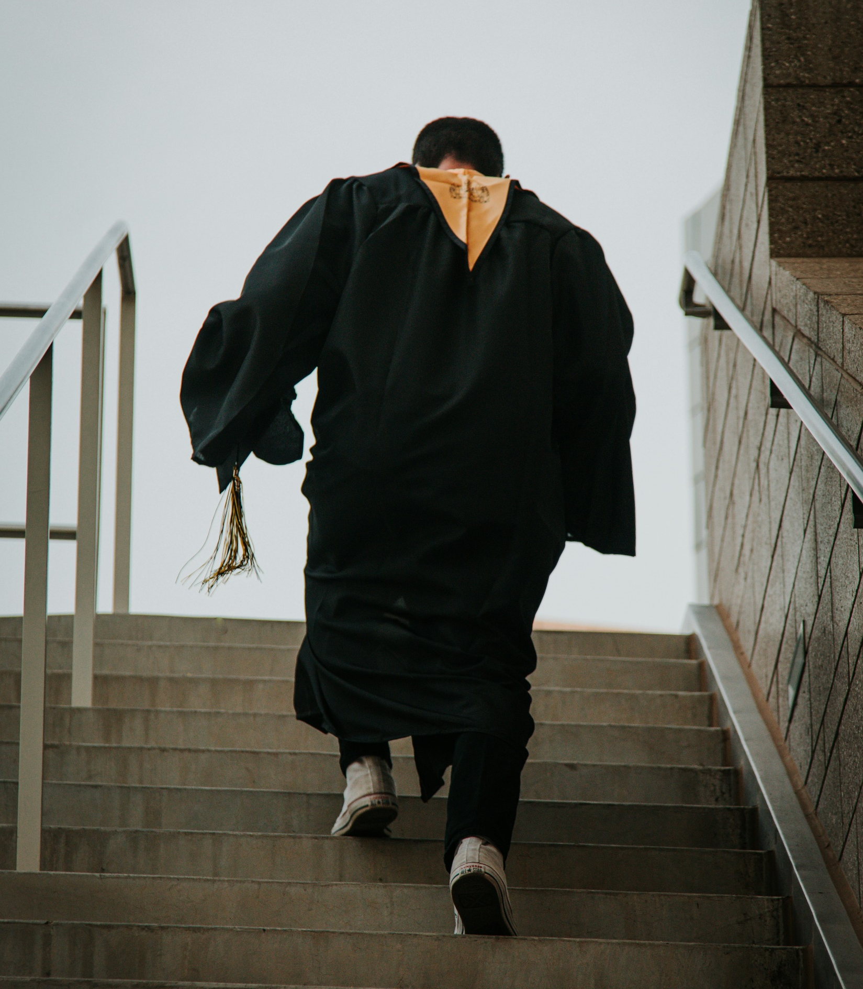
1.目標
Notes:
https://unsplash.com/photos/a-man-in-a-robe-walking-down-a-flight-of-stairs-QGOWg4m3C7o

Slide 5
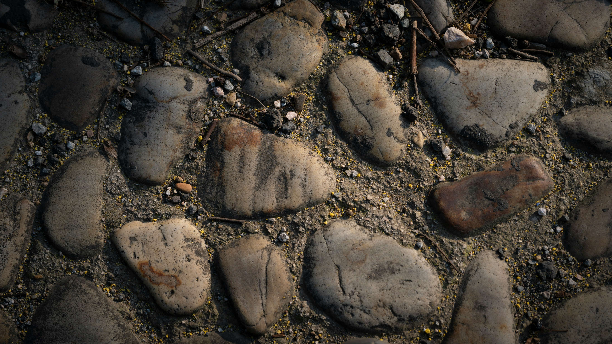
2.阻礙
Notes:
https://unsplash.com/photos/some-rocks-and-dirt-on-the-ground-TWEbDK0yJoU

Slide 6
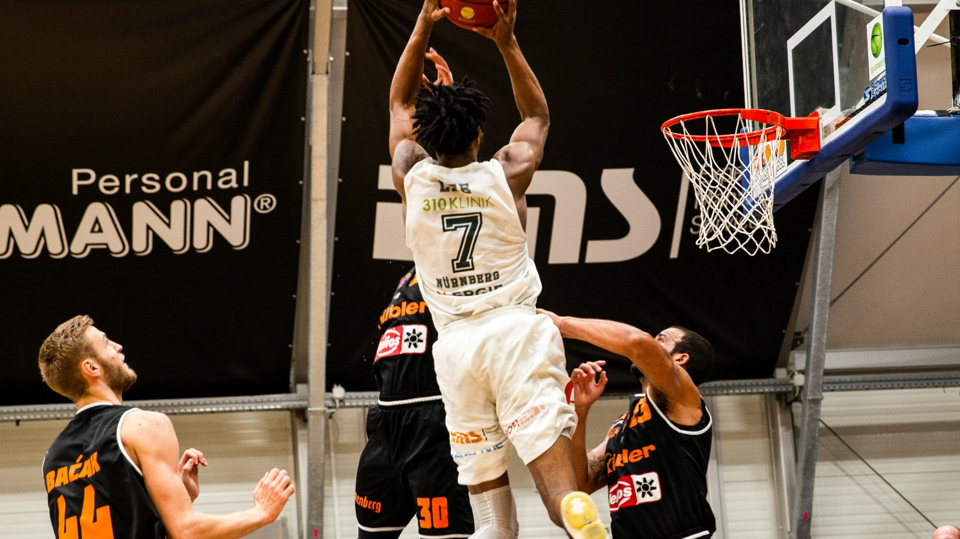
2.阻礙
Notes:
https://unsplash.com/photos/people-playing-basketball-inside-court-oXS1f0uZYV4

Slide 7
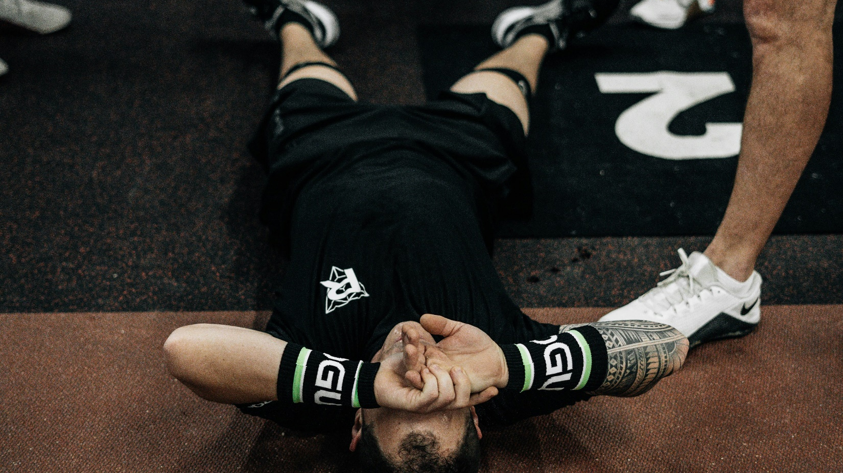
2.阻礙
Notes:
https://unsplash.com/photos/a-man-laying-on-the-ground-in-a-gym-obGBzomHstc

Slide 8
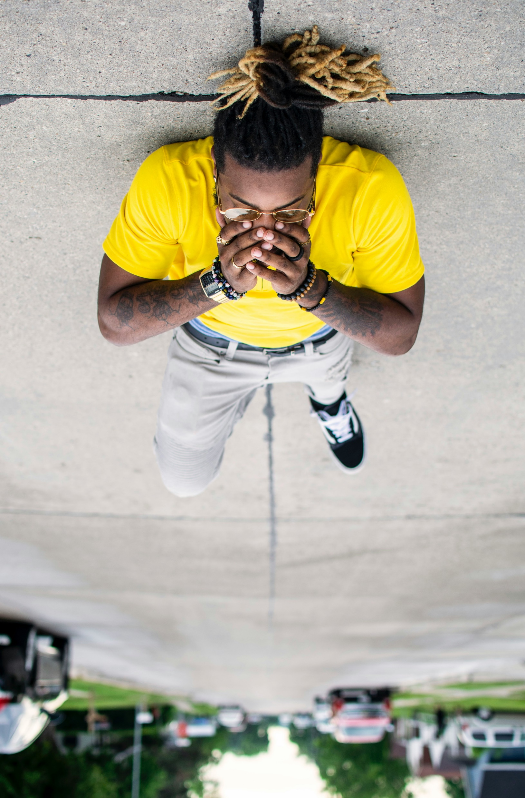
2.阻礙
Notes:
https://unsplash.com/photos/man-lying-on-gray-concrete-pavement-RhCQUafv_qk

Slide 9

2.阻礙
Notes:
https://unsplash.com/photos/open-book-lot-Oaqk7qqNh_c

Slide 10
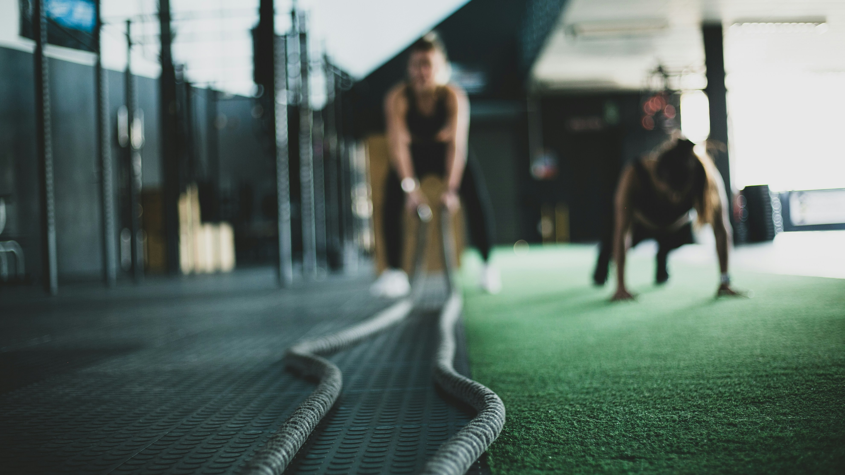
3.努力
Notes:
https://unsplash.com/photos/two-person-inside-gym-exercising-buWcS7G1_28

Slide 11
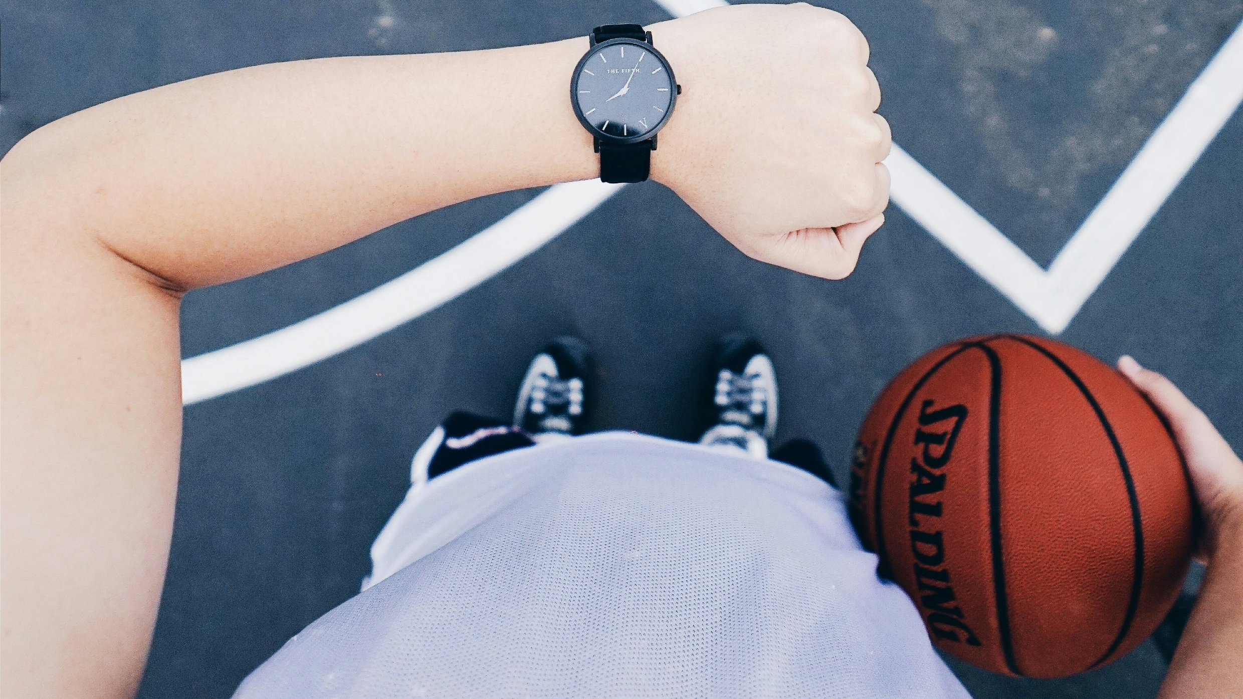
3.努力
Notes:
https://unsplash.com/photos/person-wearing-black-analog-watch-IQYR7N67dhM

Slide 12
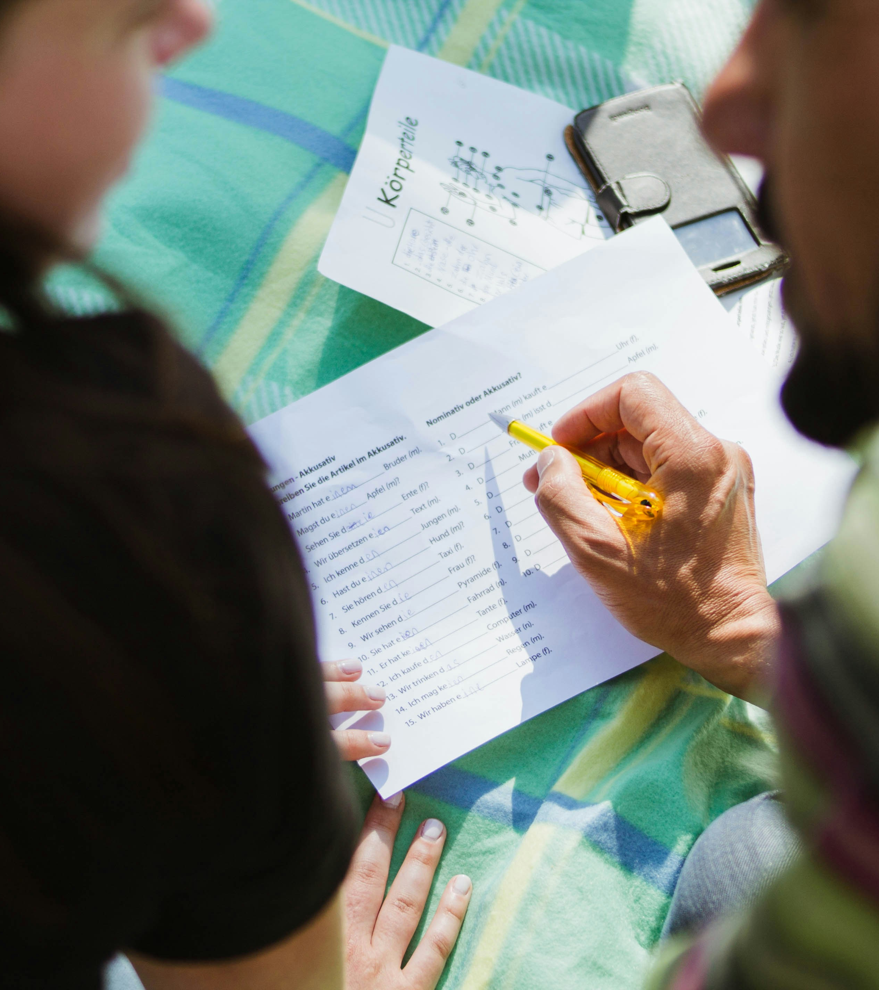

3.努力
Notes:
https://unsplash.com/photos/man-in-black-shirt-sitting-beside-woman-in-gray-shirt-cZISY8ai2iA

Slide 13

4.結果
Notes:
https://unsplash.com/photos/black-iphone-7-FxtIWX8Q0J4

Slide 14
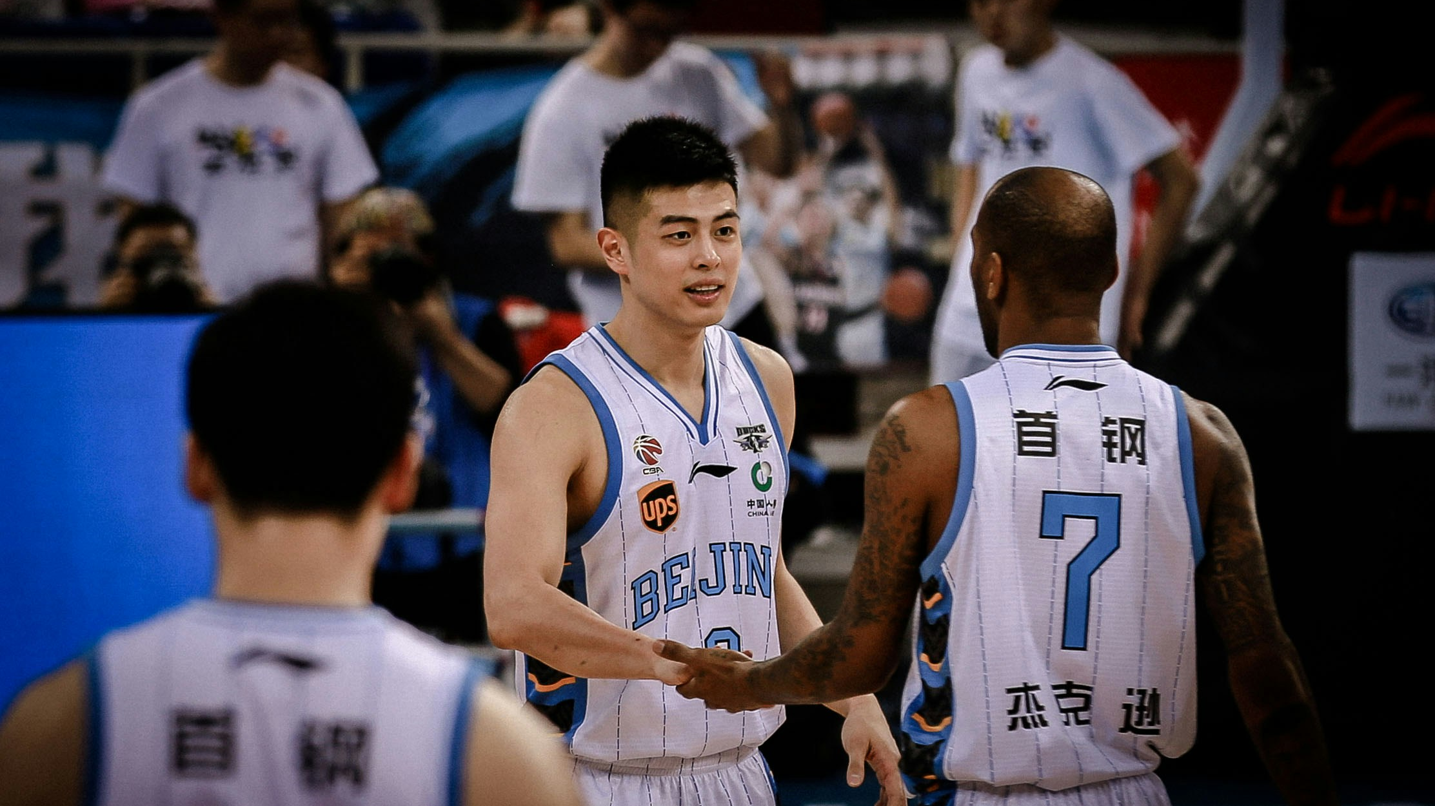
4.結果
Notes:
https://unsplash.com/photos/photo-of-man-holding-another-mans-hand-G7Qq0lZv4oo

Slide 15
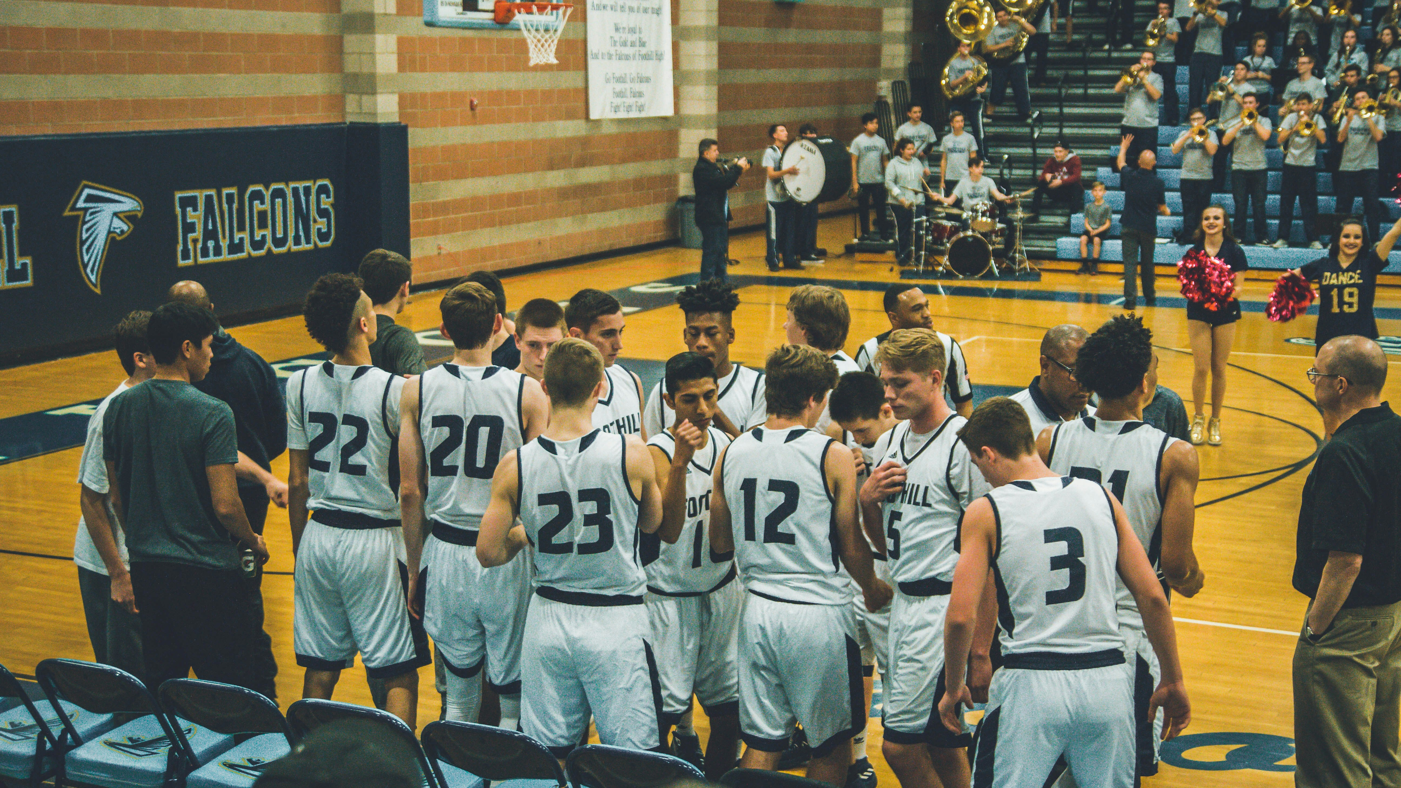
4.結果
Notes:
https://unsplash.com/photos/basketball-team-standing-on-courtside-O4zhy0zLAQc

Slide 16
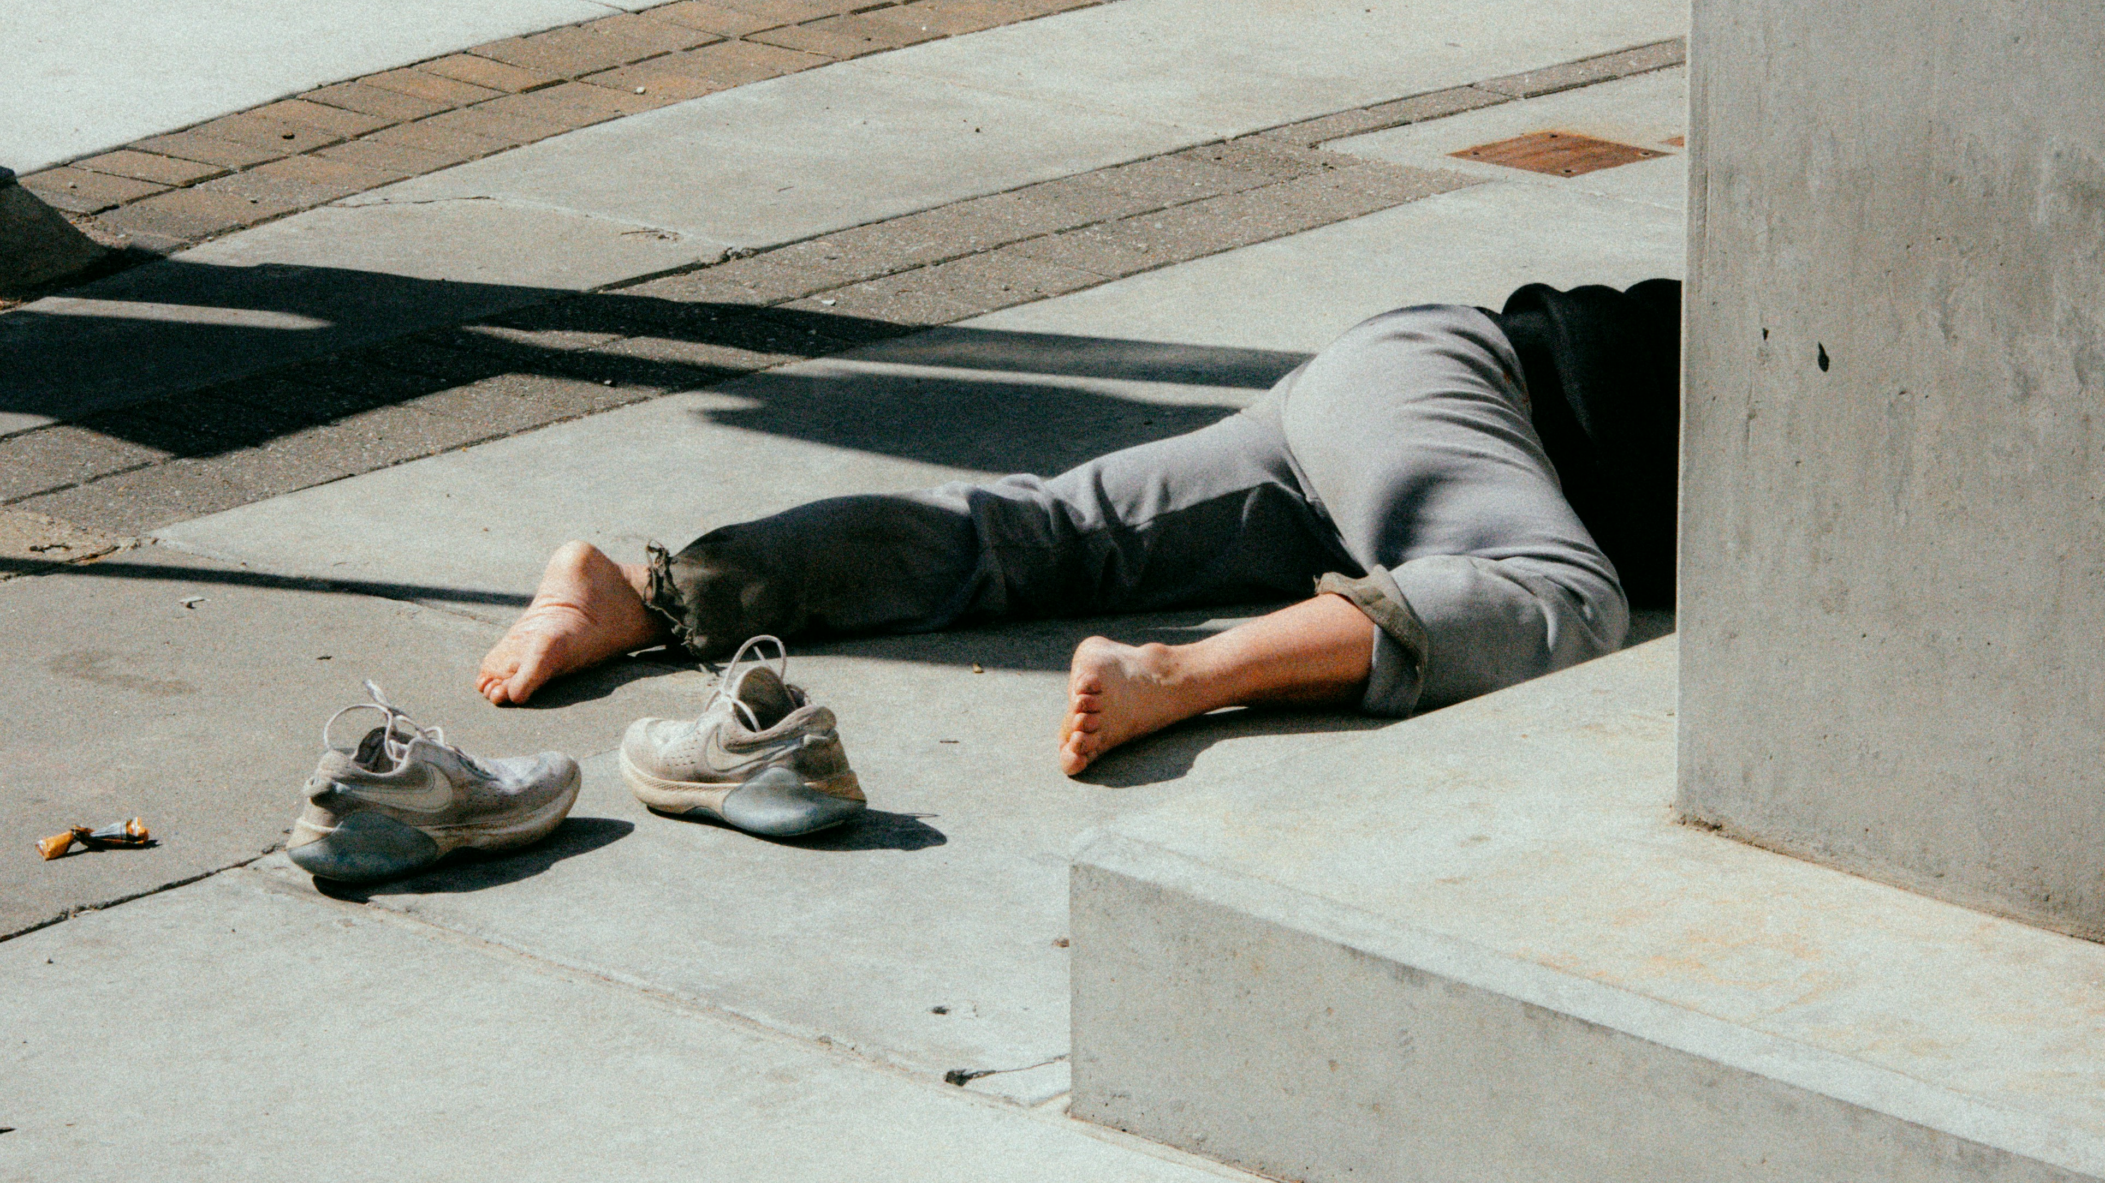
5.意外
Notes:
https://unsplash.com/photos/person-in-gray-pants-and-gray-shoes-sitting-on-concrete-bench-S9C4euiw5y4

Slide 17
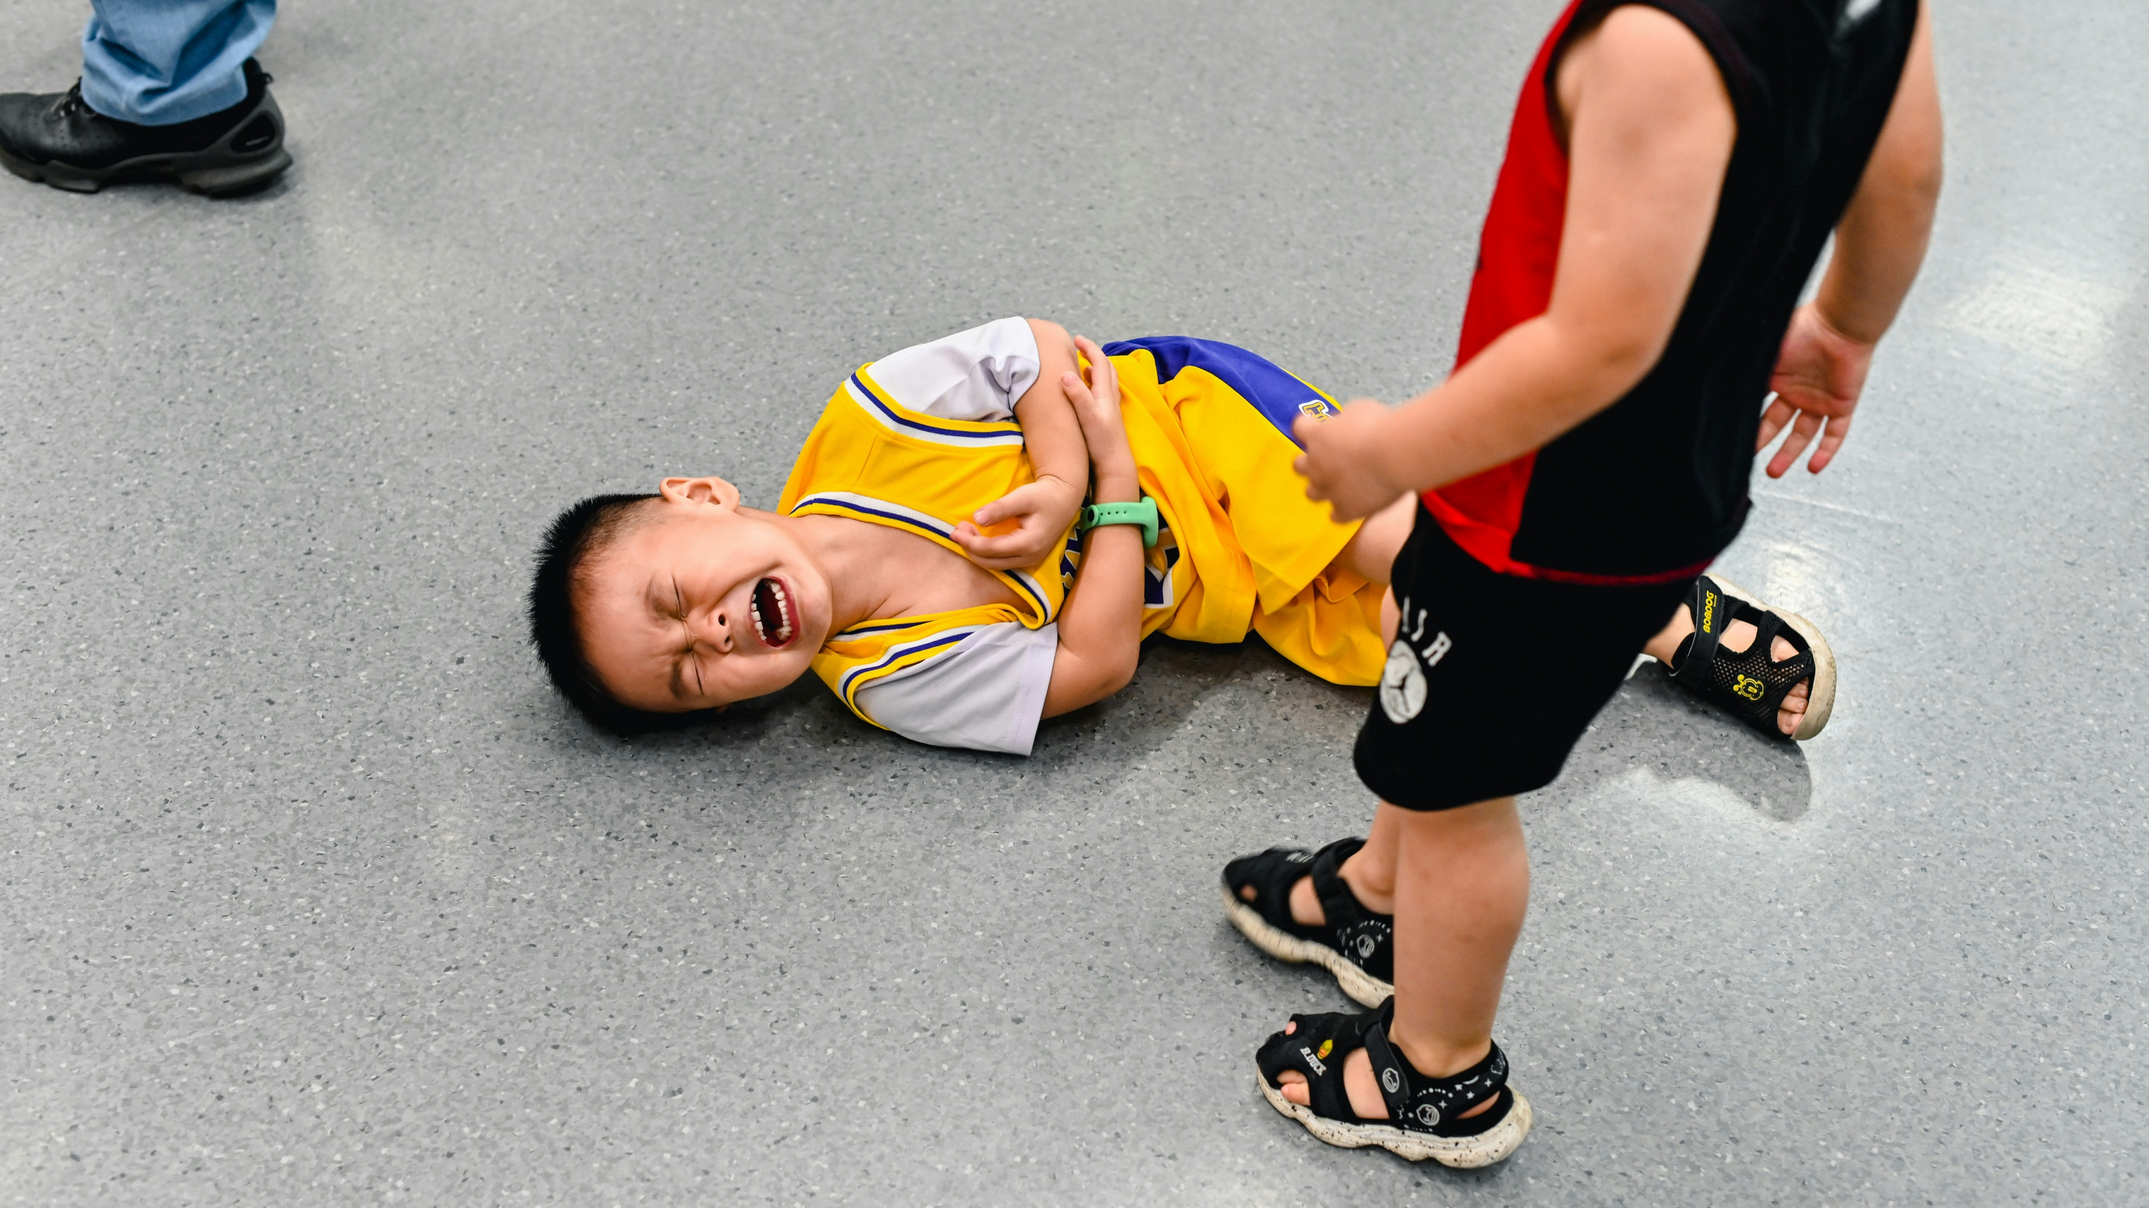
5.意外
Notes:
https://unsplash.com/photos/2-boys-lying-on-the-ground-Z5Lsb65XoCE

Slide 18
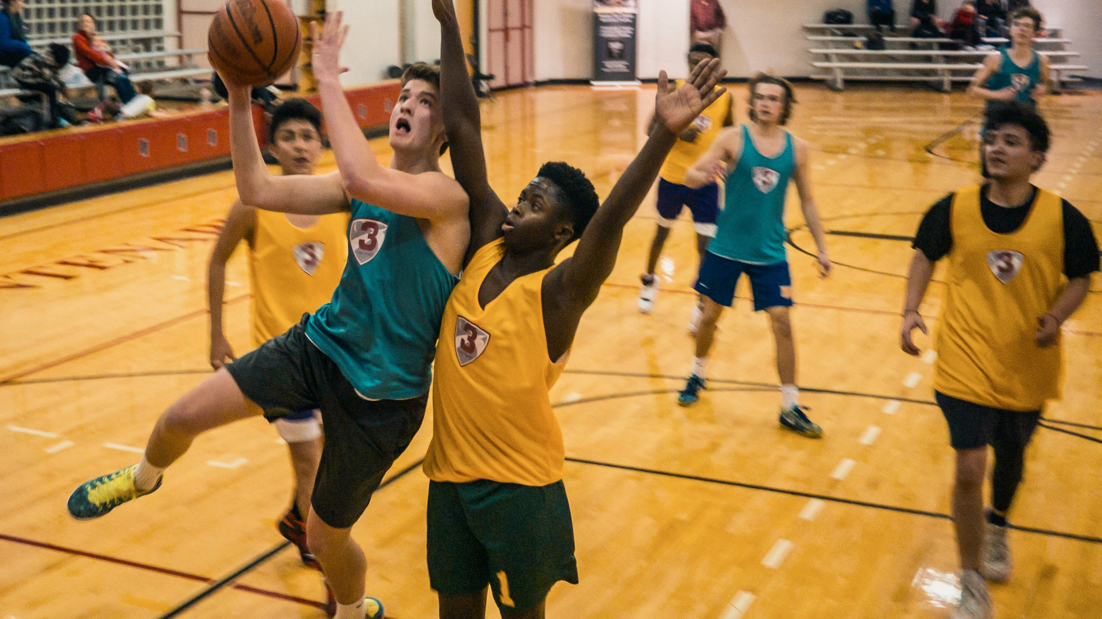
5.意外
Notes:
https://unsplash.com/photos/group-of-people-playing-basketball-BWRyS1-KKrs

Slide 19
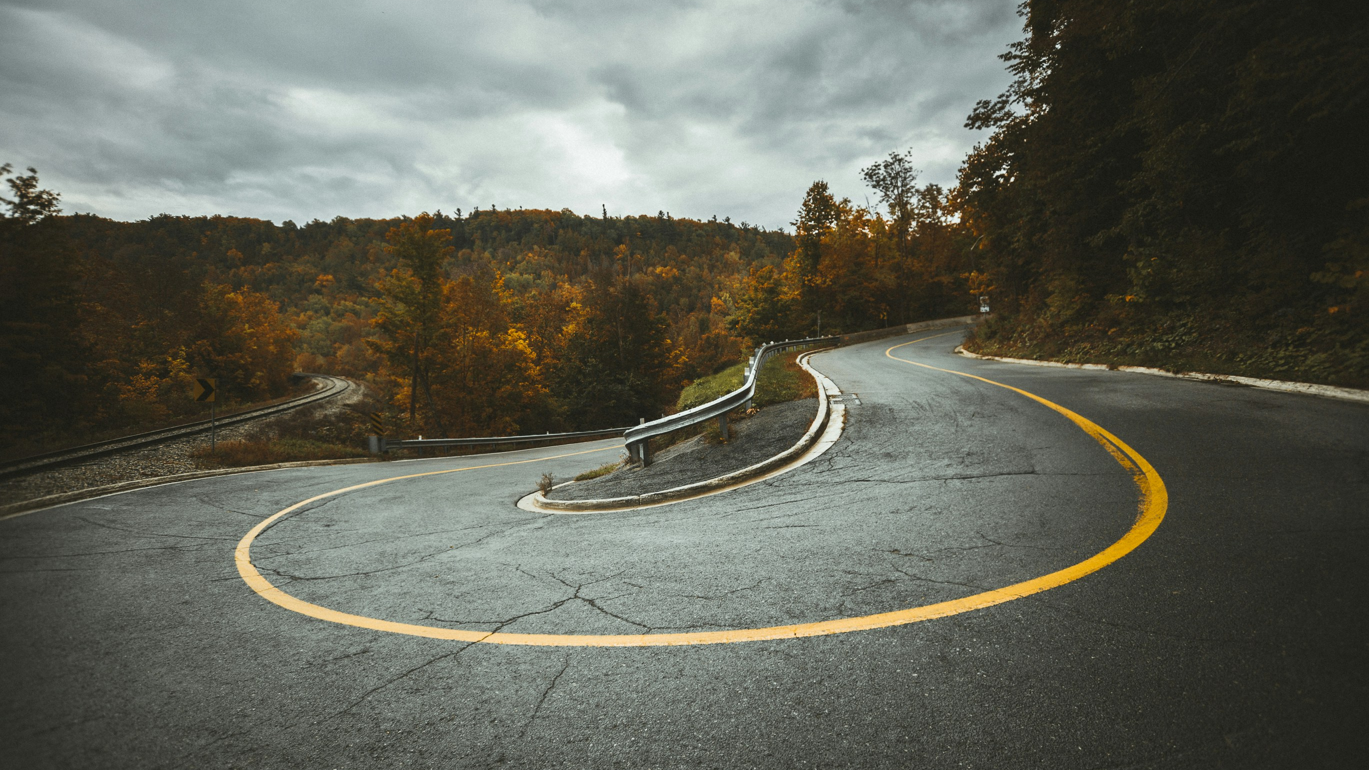
6.轉彎
Notes:
https://unsplash.com/photos/aerial-view-of-highway-near-trees-UOa7TTCyxME

Slide 20
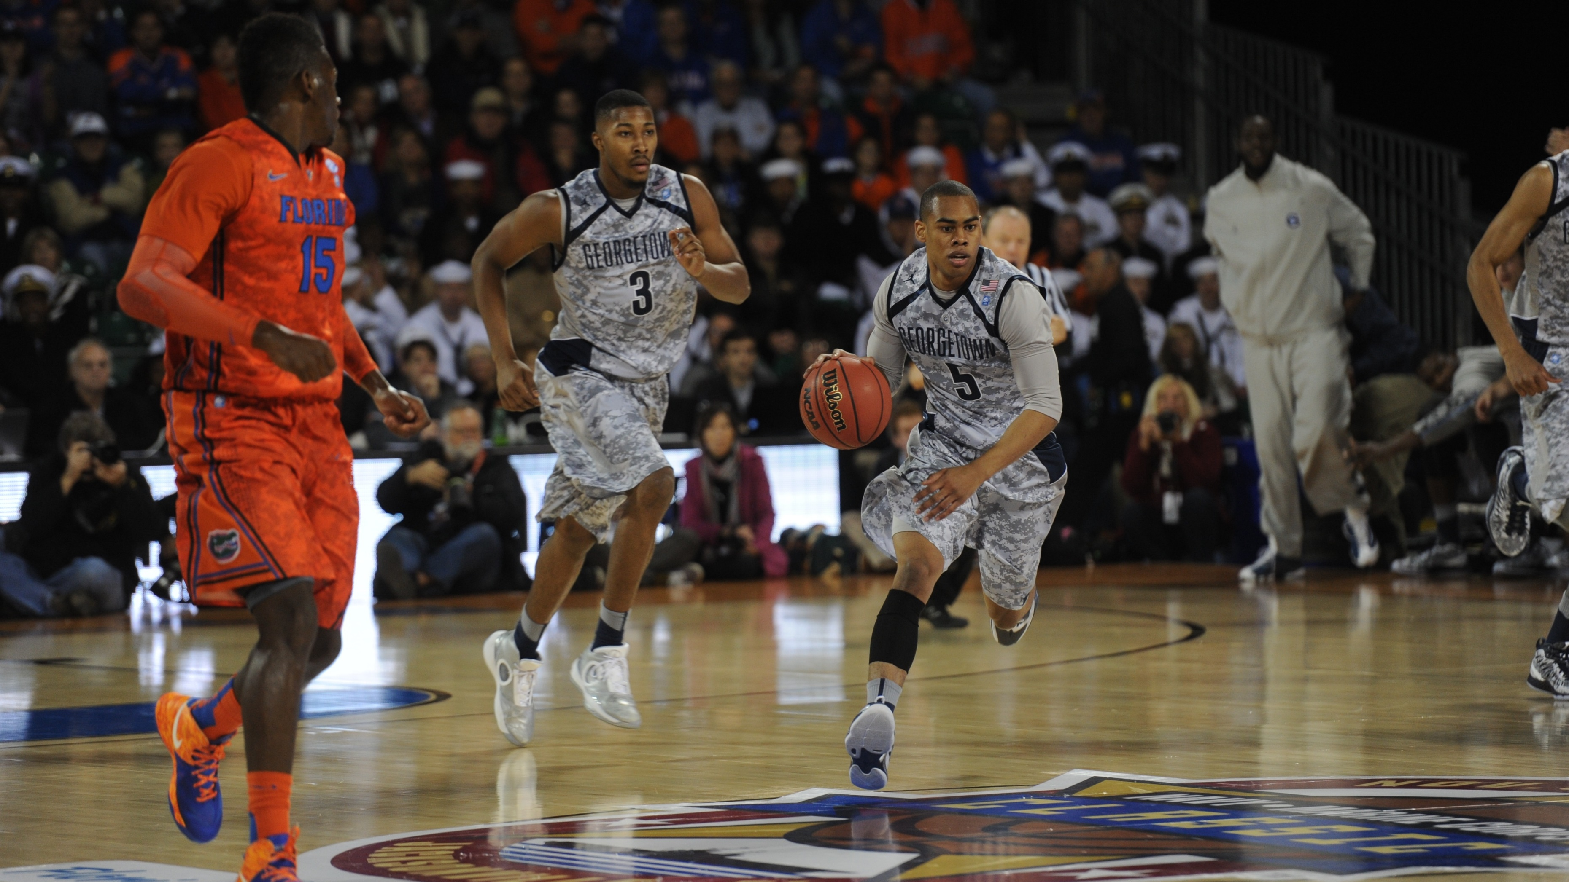
6.轉彎
Notes:
https://www.stockvault.net/photo/201626/playing-basketball#

Slide 21
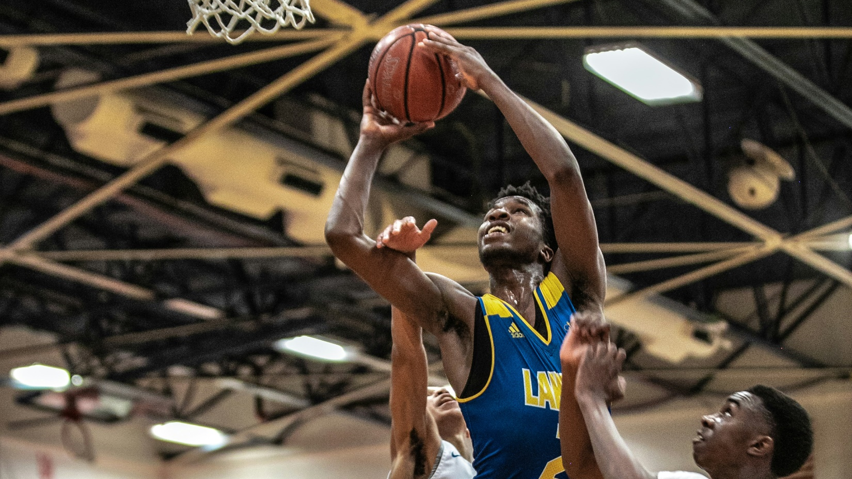
6.轉彎
Notes:
https://unsplash.com/photos/man-in-blue-jersey-shirt-playing-basketball-EpUEcJKIs6s

Slide 22

7.結局
Notes:
https://unsplash.com/photos/white-brick-wall-with-black-and-white-graffiti-BjQTmNKlawg

Slide 23
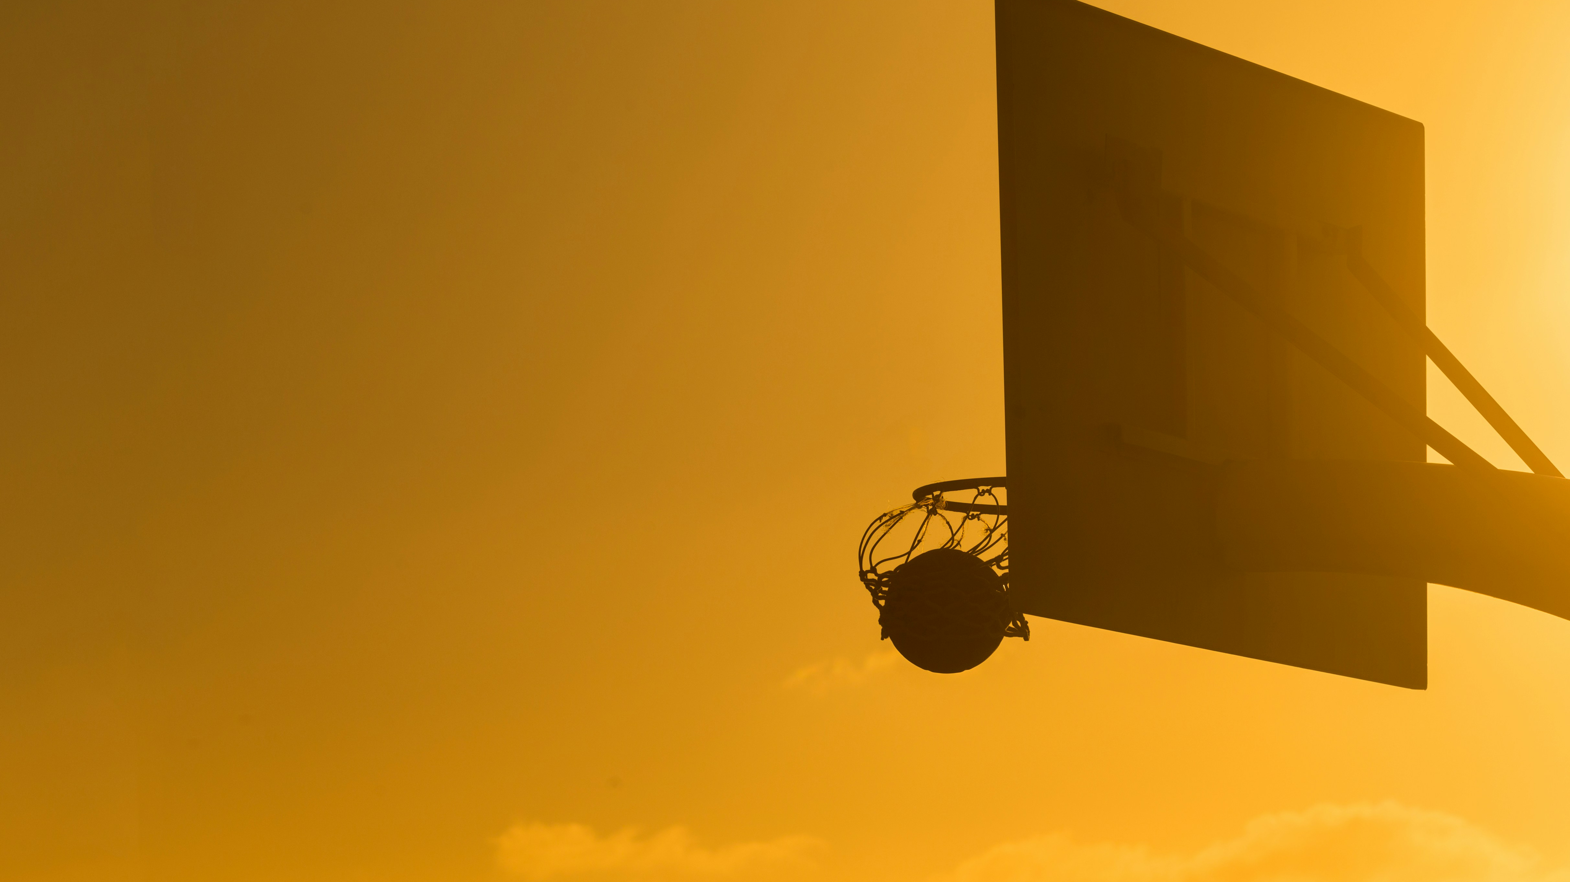
7.結局
Notes:
https://unsplash.com/photos/basketball-on-basketball-ring-DVpn-Ot0fV4

Slide 24
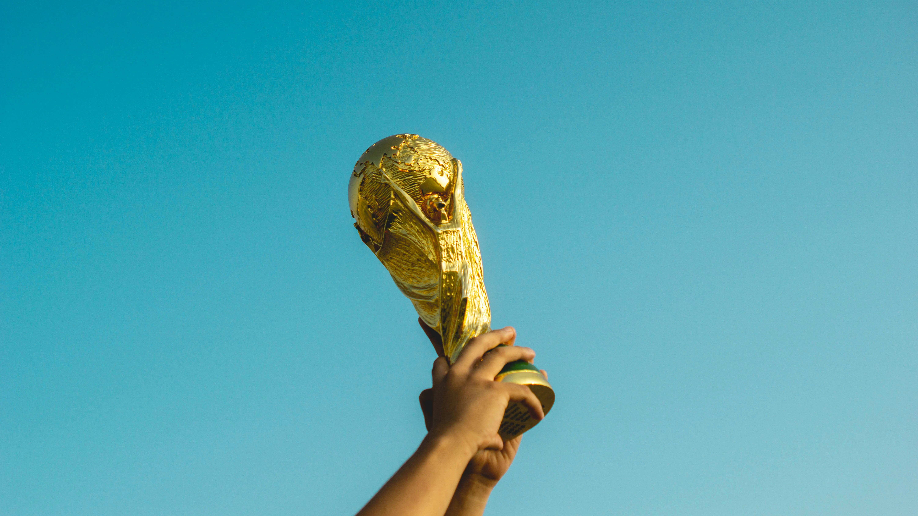
7.結局
Notes:
https://unsplash.com/photos/person-holding-gold-trophy-AmhdN68wjPc

